Slide 1


LLM Agents
Super AI Engineer (Season 5)
Ye Kyaw Thu Lab Leader, LU Lab., Myanmar
Visiting Professor, NECTEC, Thailand
24 June 2025 (Tue)

Slide 2
Table of Content
Testing LLM Intelligence
Why Agents are Essential for LLMs
The Evolution of Software Development
Diverse Applications of LLM Agents
LLM Agents Basics and R&Ds
Demo
Don’t Build Multi-Agents
Summary

Slide 3
Testing LLM Intelligence
To assess the intelligence of large language models (LLMs), I conducted experiments focusing on two key dimensions:
Multimodal reasoning testing: ChatGPT-4o's ability to interpret and explain the meaning behind a cartoon image, and
Cross-linguistic comprehension evaluating: Gemini 1.5 Pro's understanding of Myanmar-language proverbs by asking it to explain them in both English and Myanmar.
These scenarios examine how well LLMs handle visual abstraction and cultural-linguistic nuance, revealing strengths and limitations in their intelligence.

Slide 4
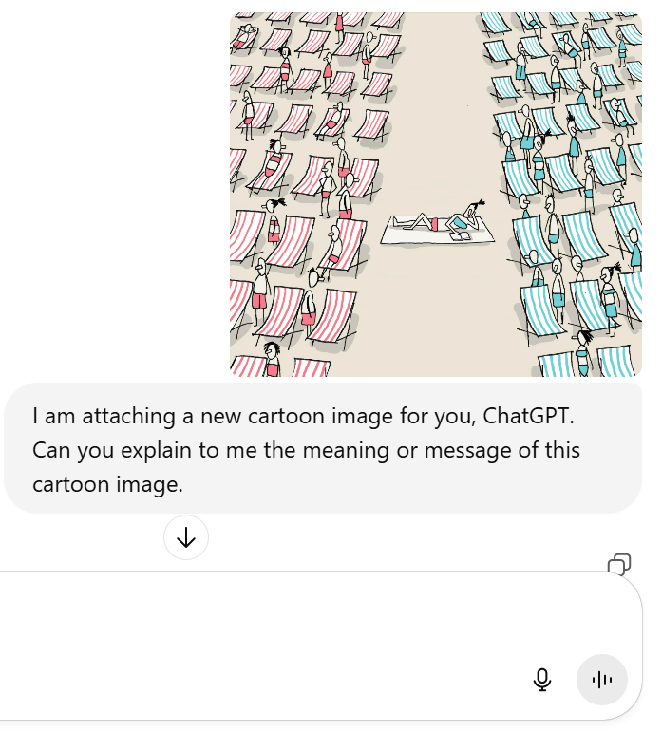
Testing LLM Intelligence(ChatGPT-4o with Cartoon Images)
In summary, the cartoon illustrates the idea of maintaining individuality and neutrality in a world that is often divided into opposing factions. It encourages the viewer to consider the benefits of not strictly aligning with one side and finding peace in a balanced or neutral stance.

Slide 5
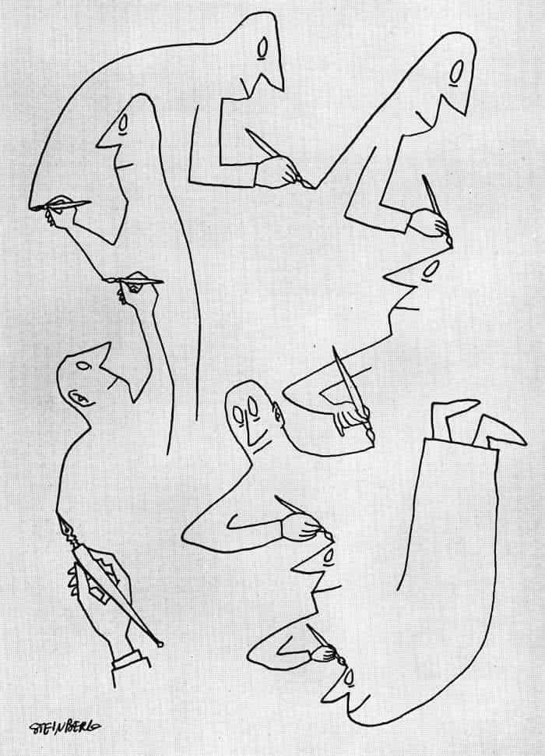
Testing LLM Intelligence(ChatGPT-4o with Cartoon Images)
The main message of the cartoon is about the interconnectedness of human actions and creativity. It suggests that everything we do is part of a larger, continuous cycle of influence and creation.
It emphasizes the idea that our contributions are part of a collective process, where we both shape and are shaped by the contributions of others.

Slide 6

Testing LLM Intelligence(ChatGPT-4o with Cartoon Images)
The cartoon portrays how addictions—whether to alcohol, nicotine, drugs, gambling, or technology—can dominate individuals' lives, reducing them to a subservient and degraded state. The people being led by these vices are depicted as powerless, crawling on all fours, illustrating how addictions can strip away personal agency, dignity, and freedom. The overall message highlights the destructive nature of these vices and the way they can enslave individuals, leading them through life rather than allowing them to walk freely on their own terms.

Slide 7
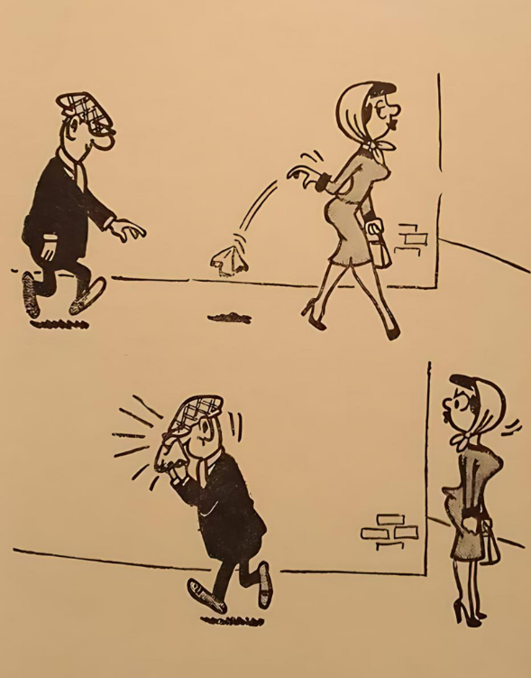
Testing LLM Intelligence(ChatGPT-4o with Cartoon Images)
In the first panel, a woman walking ahead casually drops her handkerchief behind her, which appears to be an intentional act.
A man walking behind her notices the dropped handkerchief, quickly picks it up, and chases after her in the second panel.
In the third panel, the man is eagerly running towards the woman with the handkerchief in hand, ready to return it to her.

Slide 8
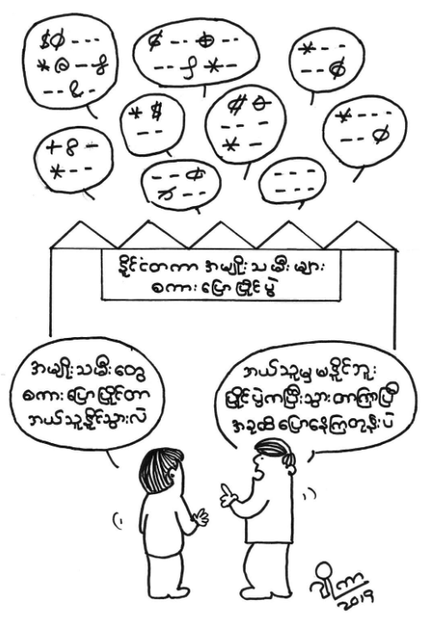
Testing LLM Intelligence(ChatGPT-4o with Cartoon Images)
The cartoon humorously critiques how official or bureaucratic language is often filled with jargon, legal terms, or complex phrases that can be confusing to the general public. It suggests that even people working within the system might not fully understand the language used, leading to miscommunication and misunderstanding. The cartoon may be a satire on how excessive complexity in language can be a barrier to clear communication and transparency.

Slide 9
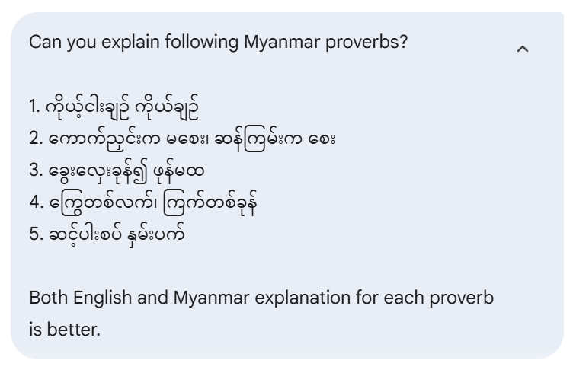
Testing LLM Intelligence
(Gemini 2.5 Flash with Myanmar Proverbs)

Slide 10
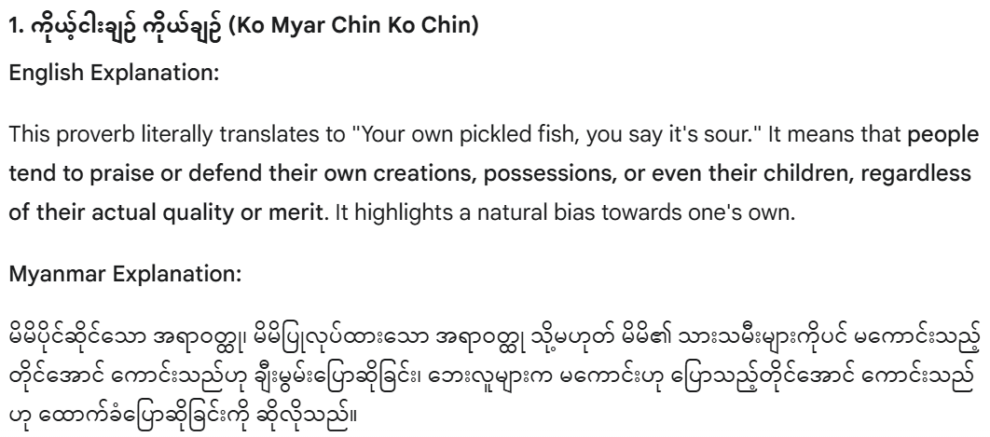
Testing LLM Intelligence
(Gemini 2.5 Flash with Myanmar Proverbs)

Slide 11
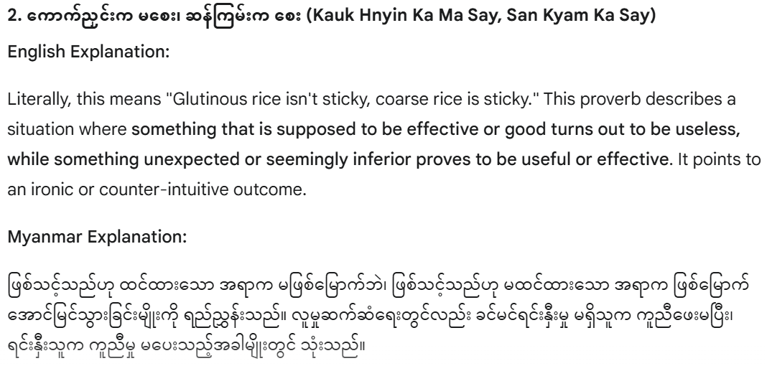
Testing LLM Intelligence
(Gemini 2.5 Flash with Myanmar Proverbs)

Slide 12
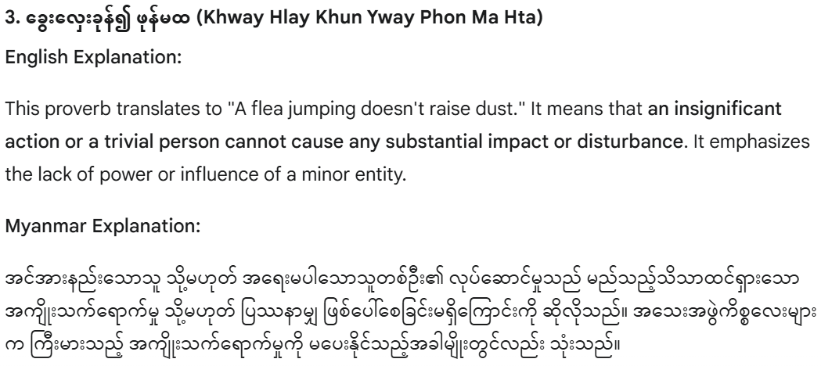
Testing LLM Intelligence
(Gemini 2.5 Flash with Myanmar Proverbs)

Slide 13
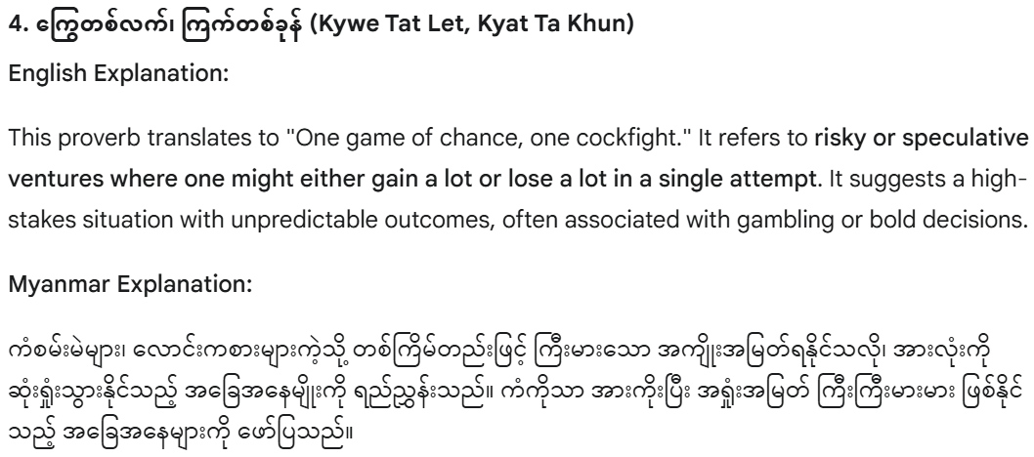
Testing LLM Intelligence
(Gemini 2.5 Flash with Myanmar Proverbs)

Slide 14
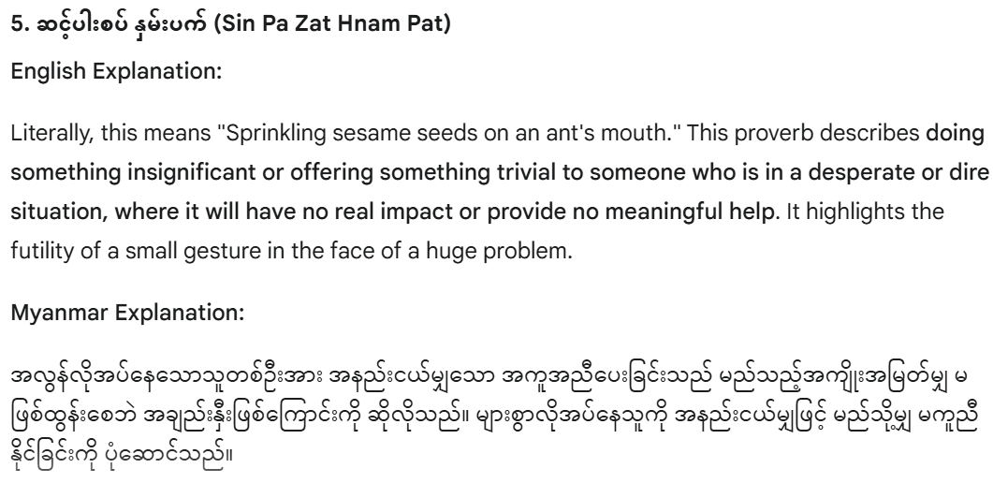
Testing LLM Intelligence
(Gemini 2.5 Flash with Myanmar Proverbs)

Slide 15
Why Agents are Essential for LLMs
Hallucination & Factual Accuracy: LLMs can generate confident but incorrect information, especially when dealing with uncertain topics.
Data Transparency & Freshness:
Lack of transparency regarding their training data.
Trained on static datasets, leading to outdated knowledge.
Limited Interaction with the Outside World:
Cannot inherently interact with real-world systems or dynamic information (even with web search capabilities, deep interaction is limited).

Slide 16
Why Agents are Essential for LLMs
Need for Context & Specialization:
Difficulty incorporating private company data or domain-specific knowledge.
Agents bridge these gaps by enabling LLMs to:
Access external tools and databases.
Perform actions in the real world.
Incorporate up-to-date and proprietary information.
Reduce hallucinations by verifying facts.

Slide 17
The Evolution of Software Development
The advent of Large Language Models is fundamentally reshaping how software is built, leading to new paradigms:
Software 1.0: Coding with Algorithms and Rules
Traditional programming where developers explicitly write logic, algorithms, and rules.
Focus on deterministic outcomes based on predefined instructions.

Slide 18
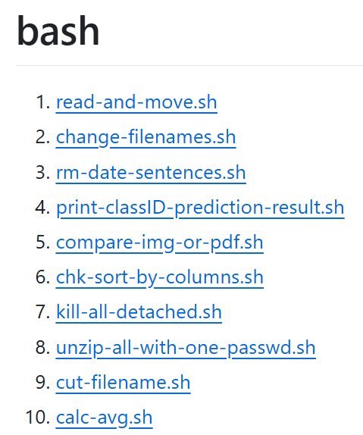
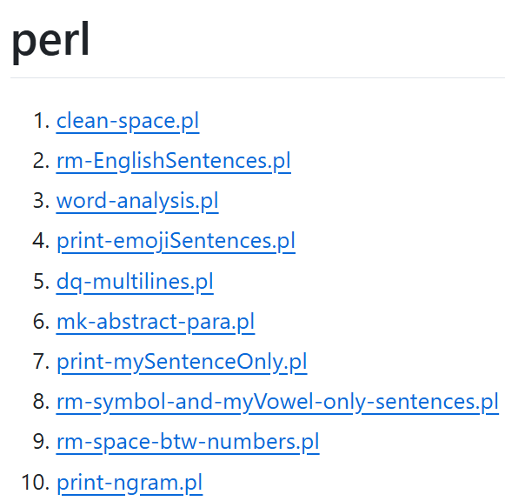
The Evolution of Software Development (Software 1.0)

Slide 19
The Evolution of Software Development
Software 2.0: Adjusting Neural Network Weights
Emergence of machine learning, where software's behavior is learned from data.
Developers primarily focus on data preparation, model architecture, and tuning parameters (e.g., weights in neural networks).
Heavily reliant on collaborative platforms like GitHub for code and model sharing.

Slide 20
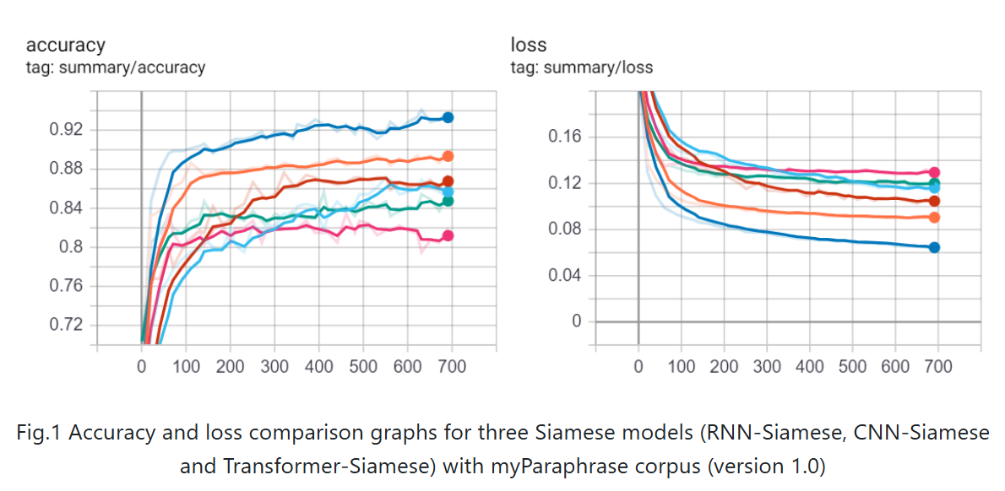
The Evolution of Software Development (Software 2.0)

Slide 21
The Evolution of Software Development
Link of Vibe Coding Wiki: https://en.wikipedia.org/wiki/Vibe_coding
Software 3.0: "Vibe Coding" or Coding with Prompting
The era of LLMs, where high-level instructions (prompts) guide code generation and system behavior.
Developers shift towards crafting effective prompts, refining LLM outputs, and orchestrating agents.
Platforms like Hugging Face become central for sharing and leveraging pre-trained models and components.

Slide 22
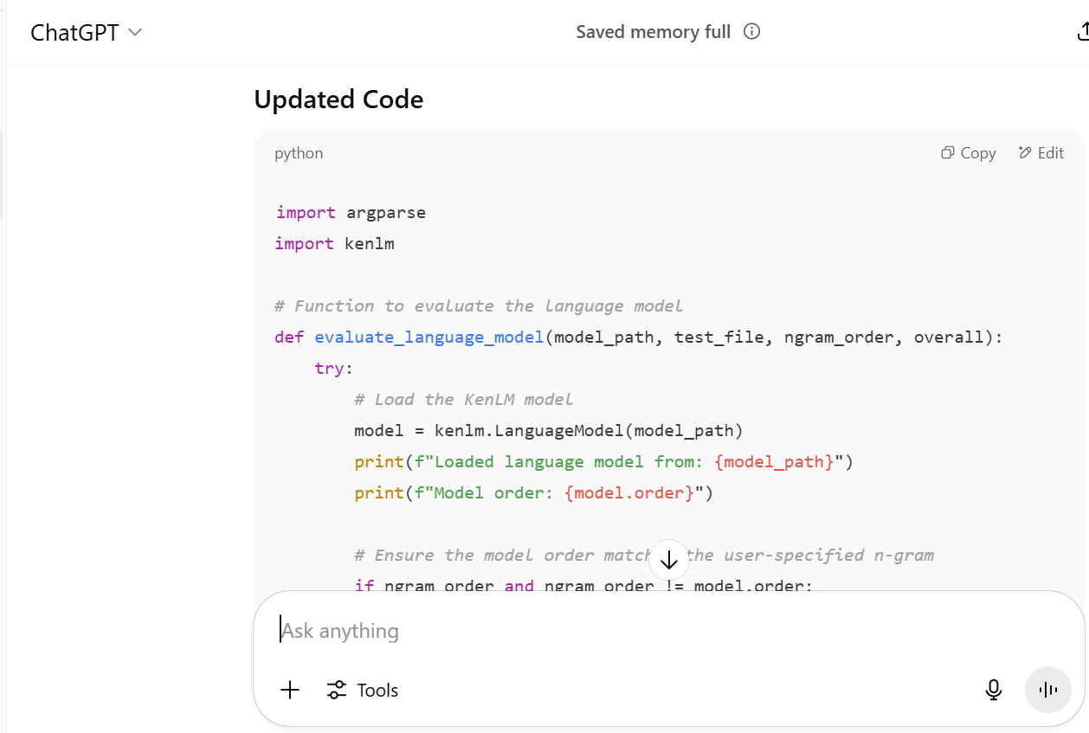
The Evolution of Software Development (Software 3.0)
GitHub Link: https://github.com/ye-kyaw-thu/tools
Prompt Engineering

Slide 23
Diverse Applications of LLM Agents
LLM Agents are rapidly being adopted across various domains, extending the capabilities of large language models. Here are some key examples:
Software Development Agents: Automating code generation, debugging, testing, and even managing entire development workflows.
Web Browsing Agents: Navigating the internet, extracting information, summarizing content, and performing tasks requiring web interaction.
Financial Analysis Agents: Analyzing market data, predicting trends, managing portfolios, and providing personalized financial advice.

Slide 24
Diverse Applications of LLM Agents
Healthcare Agents: Assisting with diagnostics, personalizing treatment plans, analyzing medical literature, and managing patient care.
E-commerce Agents: Enhancing customer support, personalizing shopping experiences, optimizing inventory, and managing logistics.

Slide 25
LLM Agents Basics and R&Ds (Tools for LLM Agents)
Shumaker et al. Animal tool behavior: the use and manufacture of tools by animals. JHU Press, 2011
An LM-used tool is a function interface to a computer program that runs external to the LM, where the LM generates the function calls and input arguments in order to use the tool.
Program
Functional
External

Slide 26
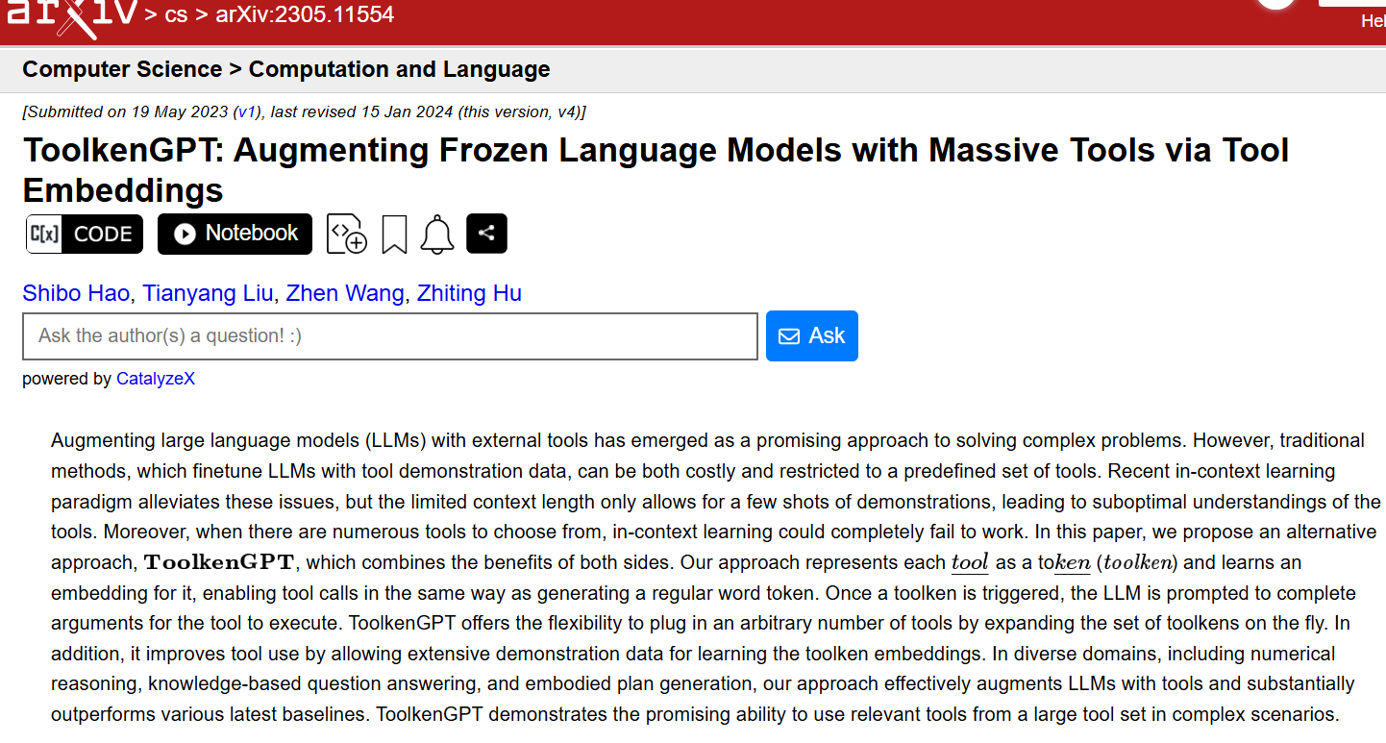
LLM Agents Basics and R&Ds (Tool Execution)

Slide 27
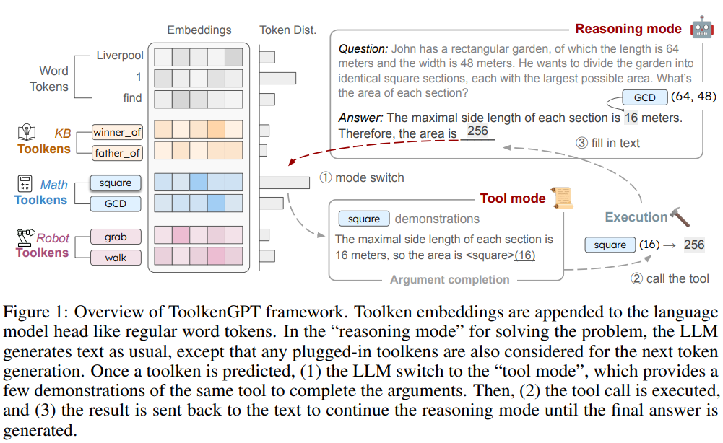
LLM Agents Basics and R&Ds

Slide 28
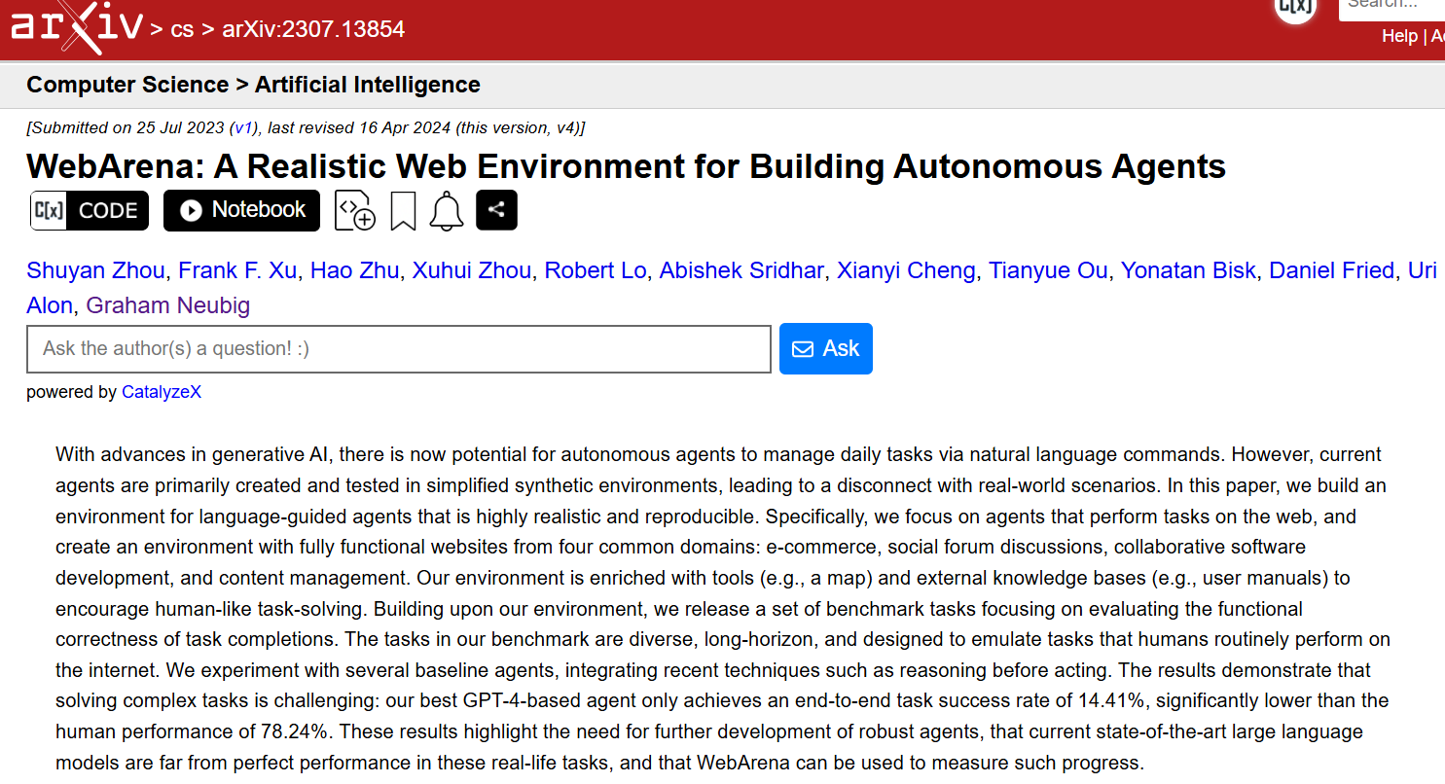
LLM Agents Basics and R&Ds (Environment Rep.)

Slide 29
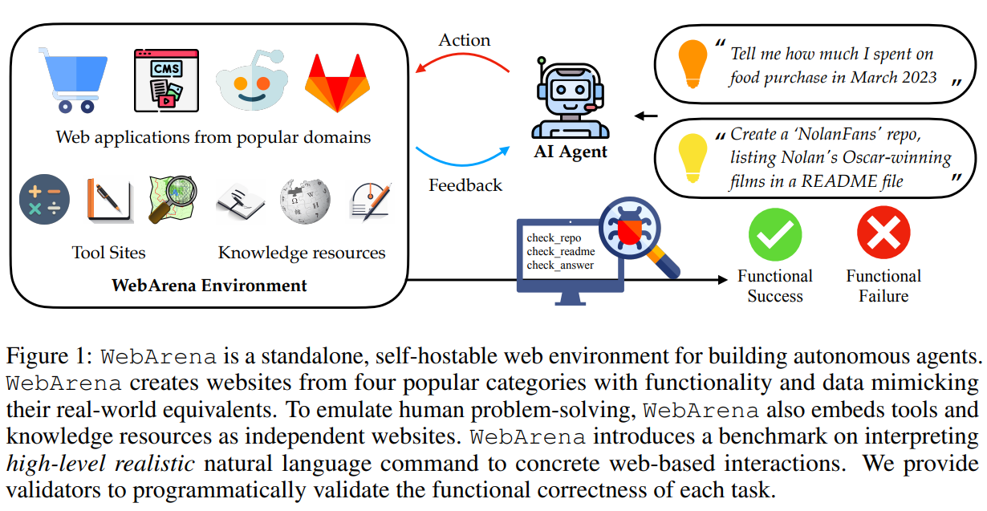
LLM Agents Basics and R&Ds (natural lang 2 web interact.)

Slide 30
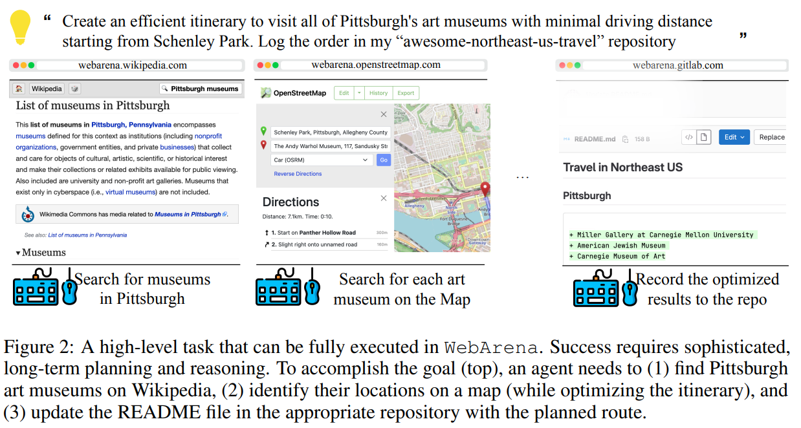
LLM Agents Basics and R&Ds

Slide 31
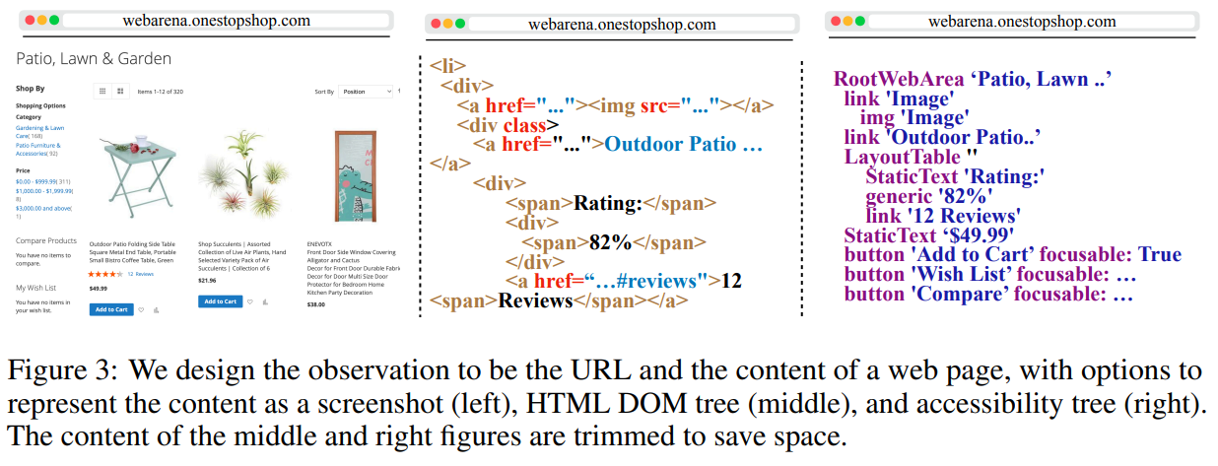
LLM Agents Basics and R&Ds

Slide 32
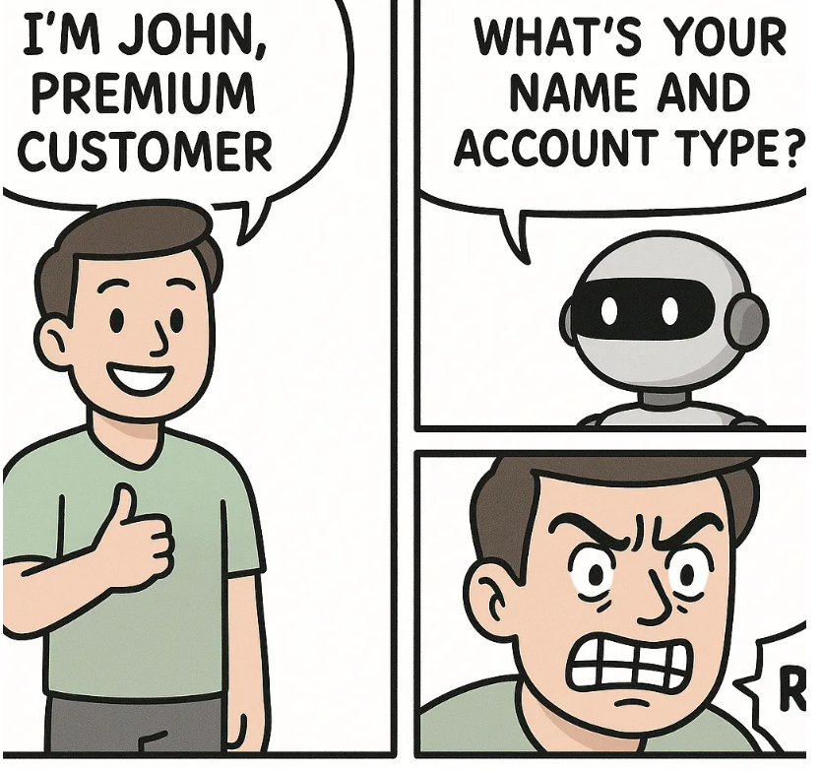
LLM Agents Basics and R&Ds (Memory Management)
Link: https://medium.com/@nomannayeem/building-ai-agents-that-actually-remember-a-developers-guide-to-memory-management-in-2025-062fd0be80a1
User: “Hi, I’m John and I need help with my premium account.”
Bot: “Hello! I’d be happy to help. What’s your name and account type?”

Slide 33
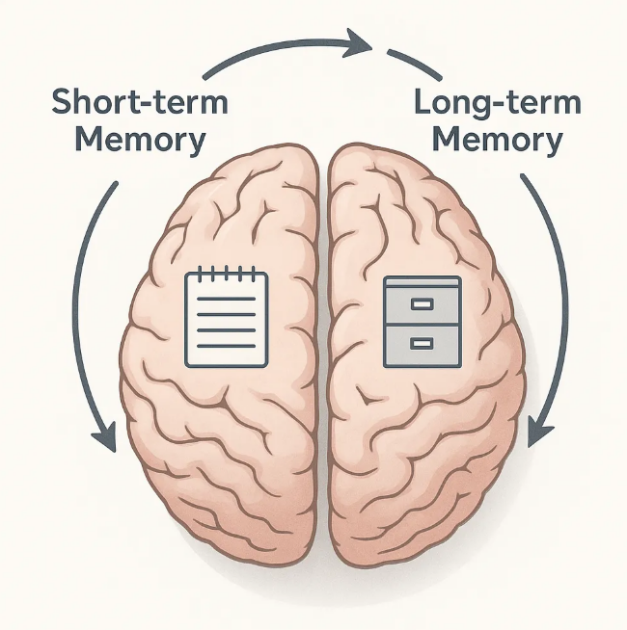
LLM Agents Basics and R&Ds
Just like humans, AI agents need two different types of memory

Slide 34
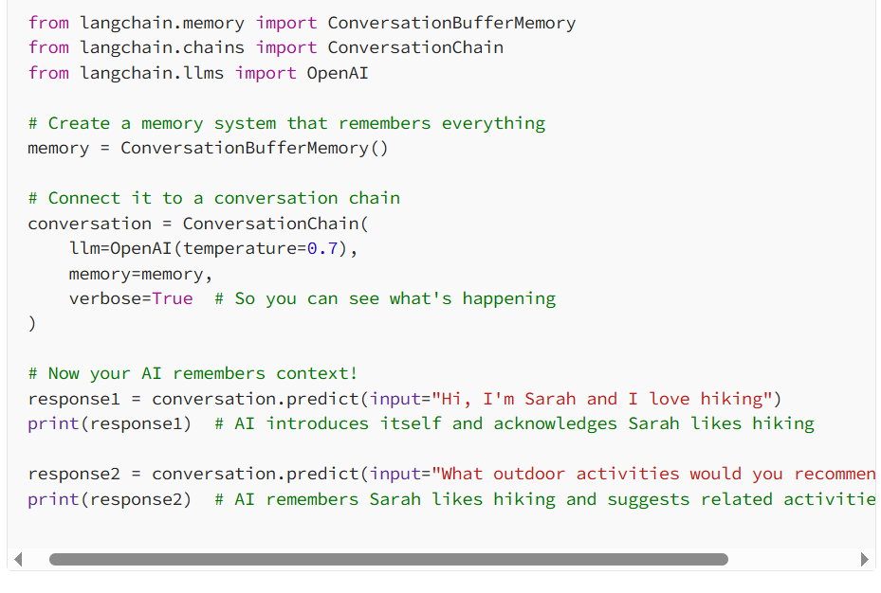
LLM Agents Basics and R&Ds

Slide 35
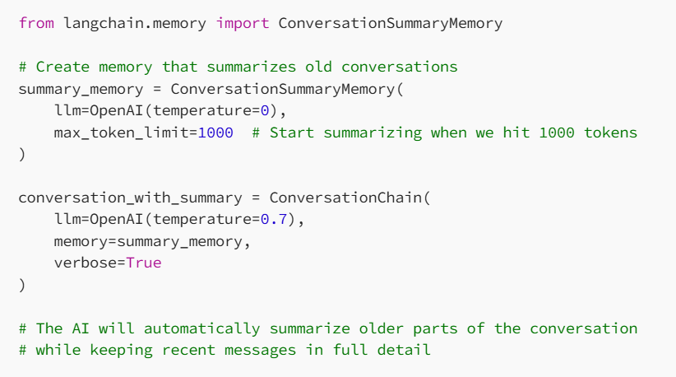
LLM Agents Basics and R&Ds

Slide 36
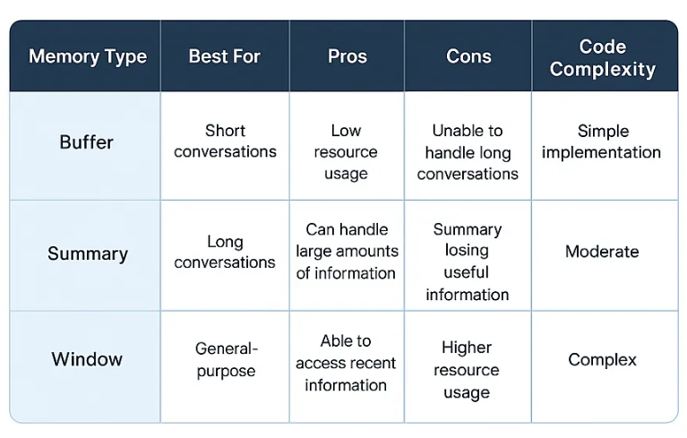
LLM Agents Basics and R&Ds
Table. Comparison of memory types

Slide 37
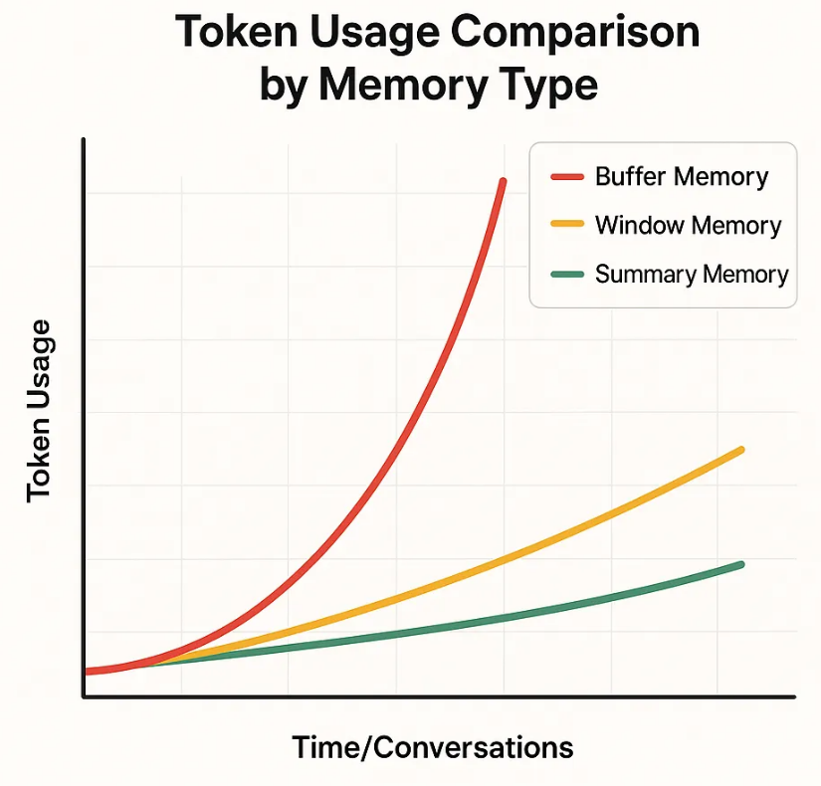
LLM Agents Basics and R&Ds
Here’s what happens behind the scenes:
Early in the conversation: AI remembers everything word-for-word
As the conversation grows: AI starts summarizing older messages
Recent messages: Still kept in full detail
Very old messages: Condensed into brief summaries

Slide 38
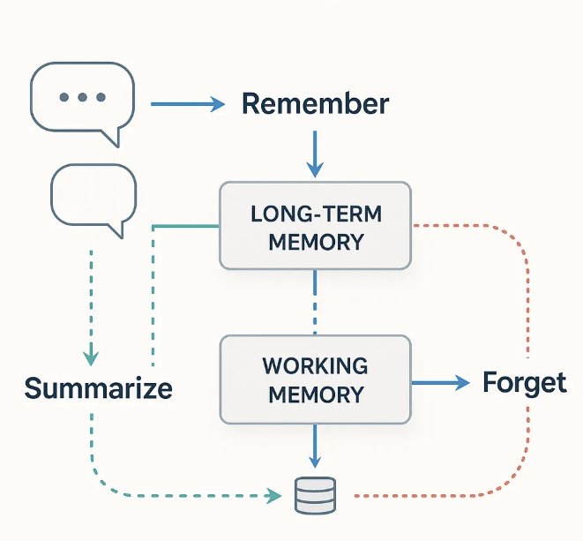
LLM Agents Basics and R&Ds
Short-term memory is like a sticky note, but long-term memory is like a filing cabinet. While short-term memory helps your AI stay coherent during a single conversation, long-term memory is what transforms your bot from a helpful tool into something that feels almost… human.

Slide 39
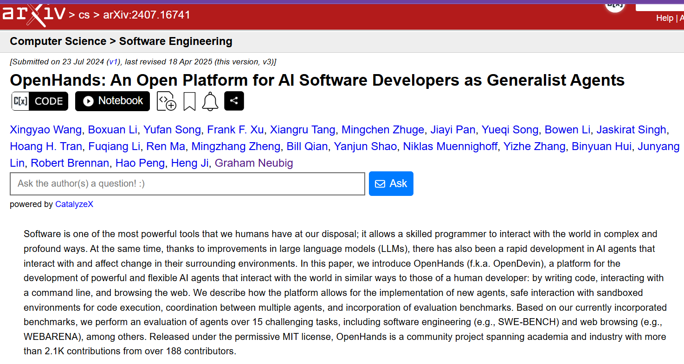
Demo: OpenHands Cloud

Slide 40
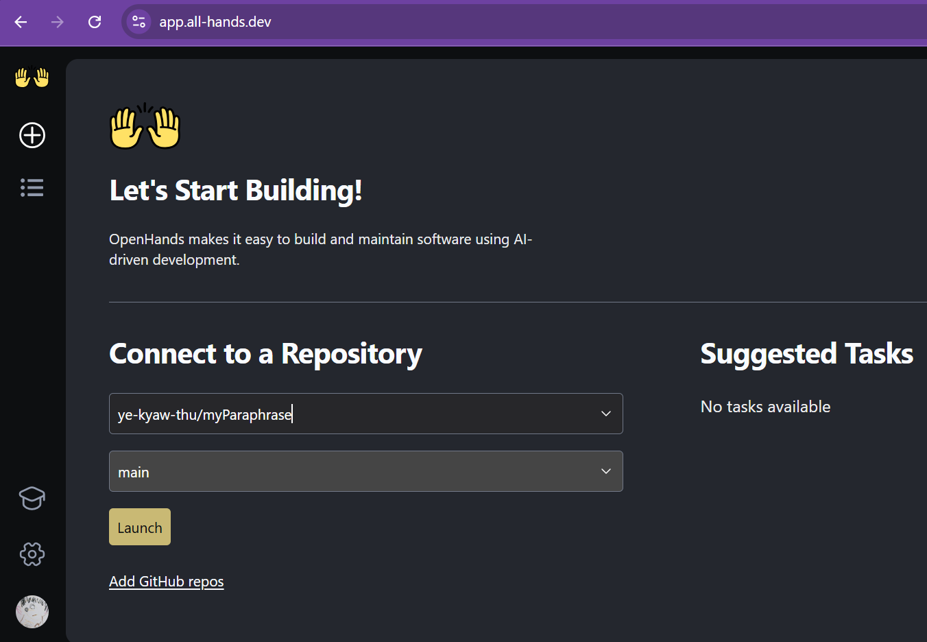
Demo: OpenHands Cloud

Slide 41
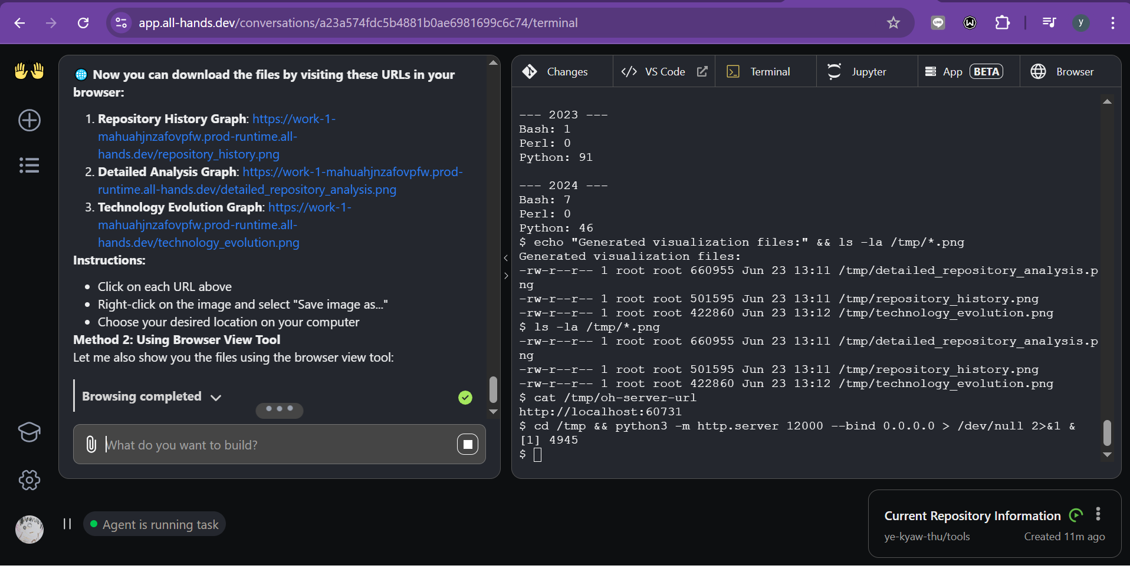
Demo: OpenHands Cloud

Slide 42
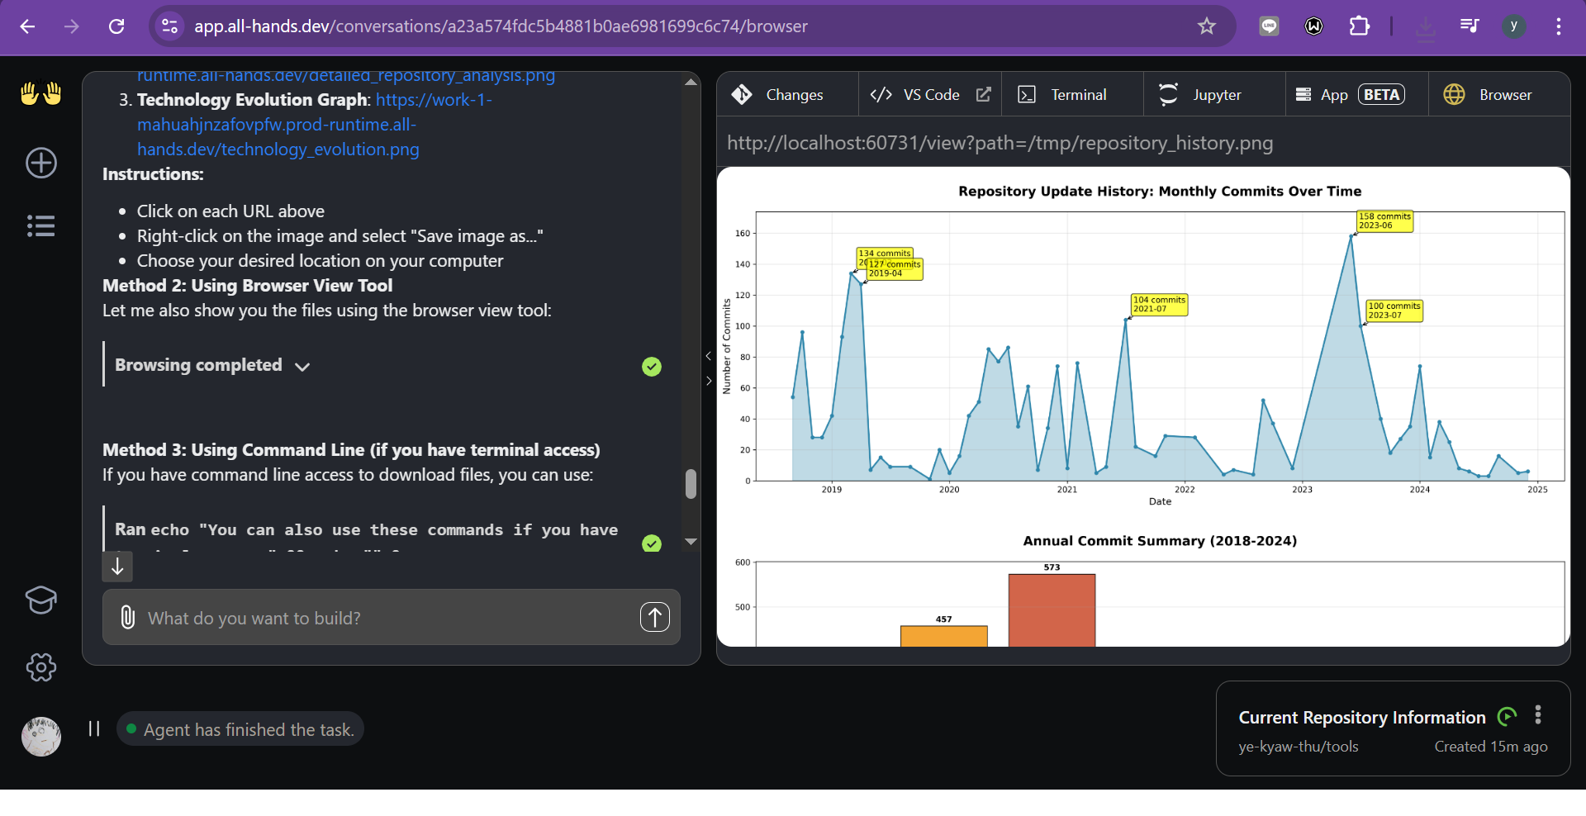
Demo: OpenHands Cloud

Slide 43
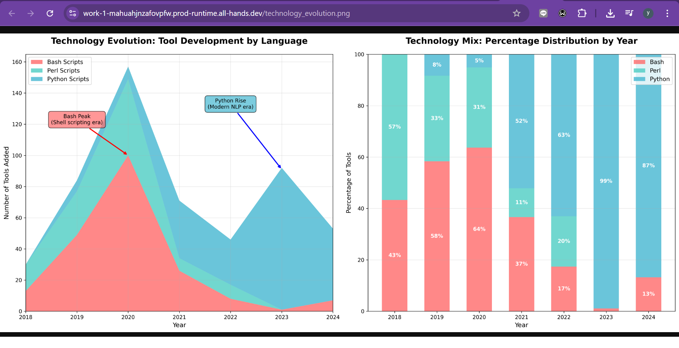
Demo: OpenHands Cloud

Slide 44
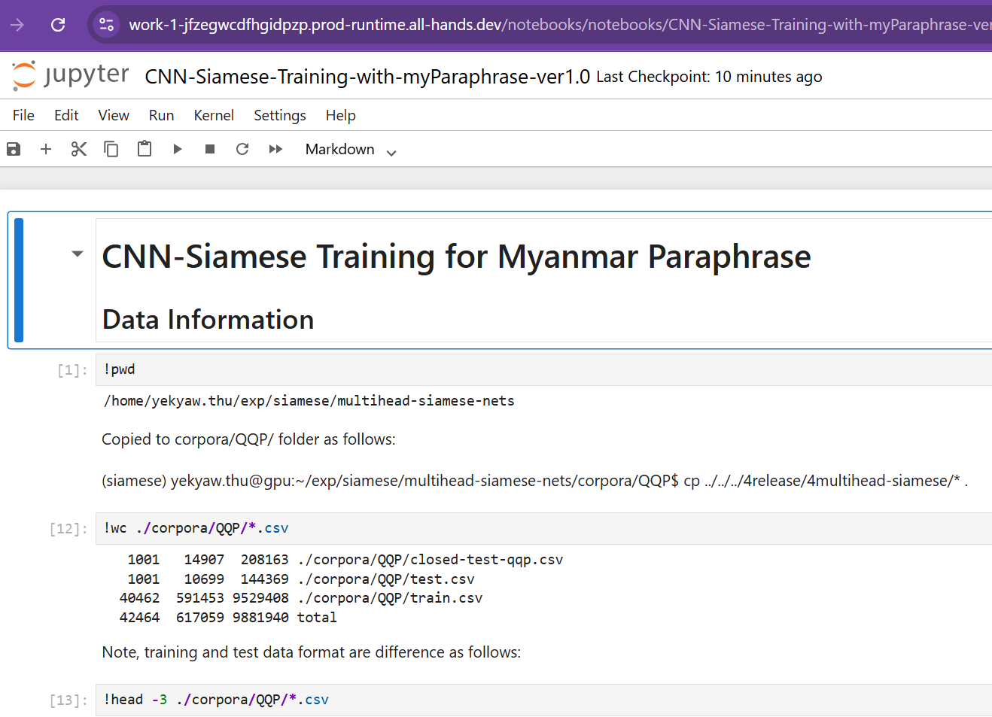
Demo: OpenHands Cloud
GitHub Link: https://github.com/ye-kyaw-thu/myParaphrase
Running Jupyter Notebook

Slide 45
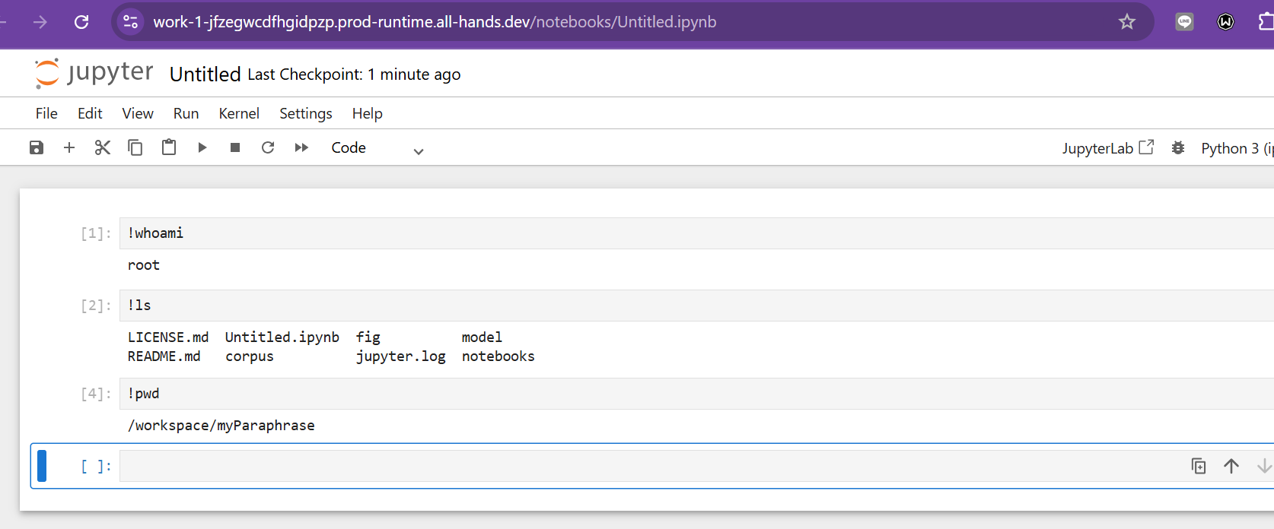
Demo: OpenHands Cloud
Very convenient
Automation of coding, github repository updating

Slide 46
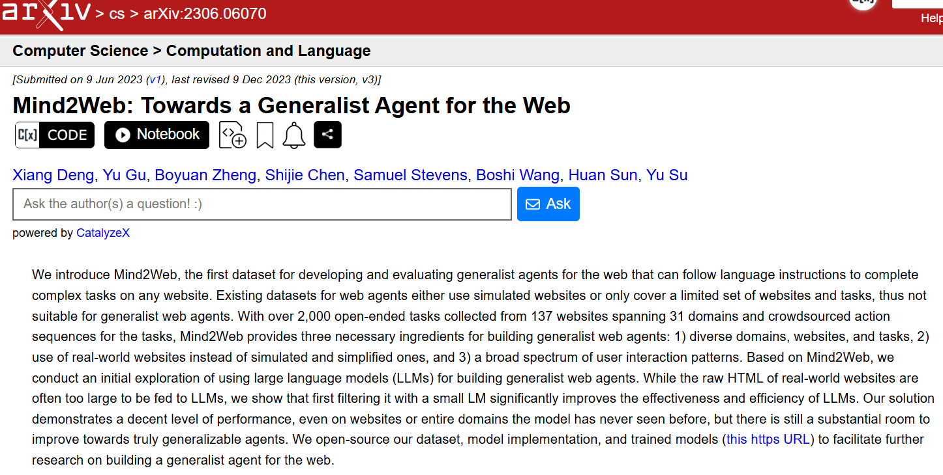
Demo: Mind2Web

Slide 47
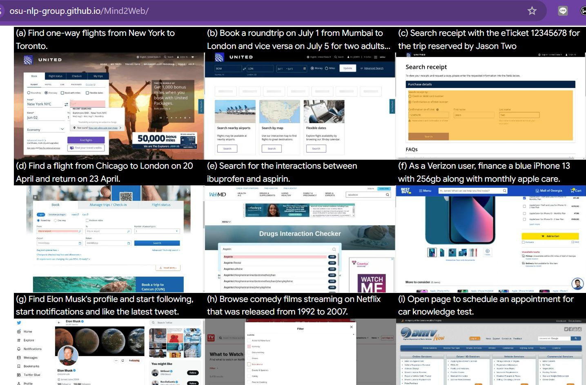
Demo: Mind2Web
Link: https://osu-nlp-group.github.io/Mind2Web/

Slide 48
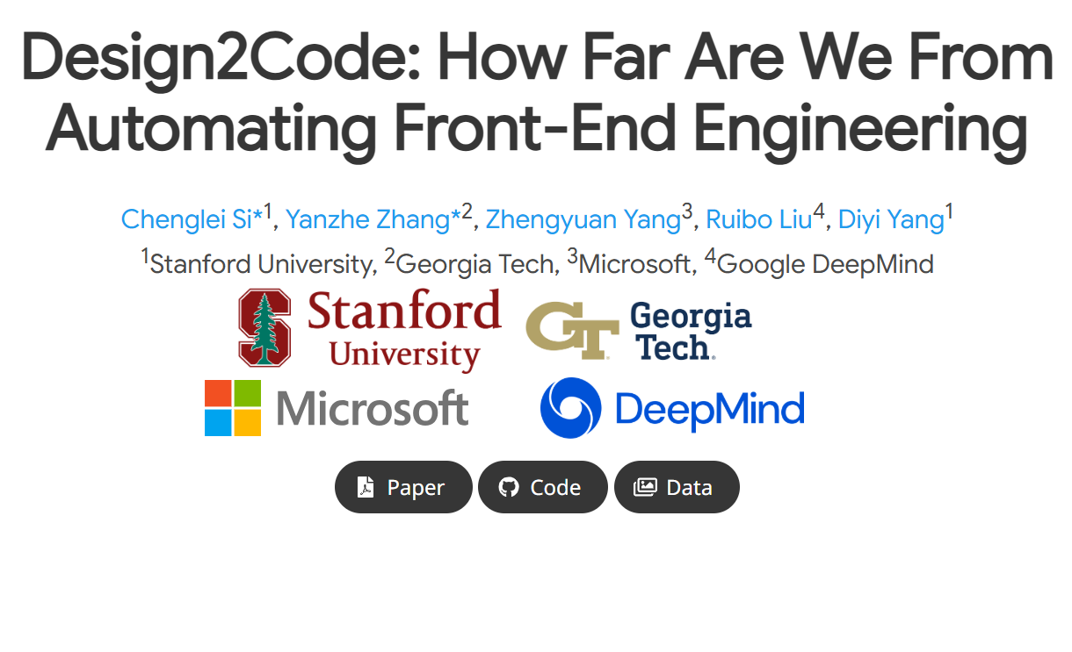
Demo: Design2Code
Link: https://salt-nlp.github.io/Design2Code/

Slide 49
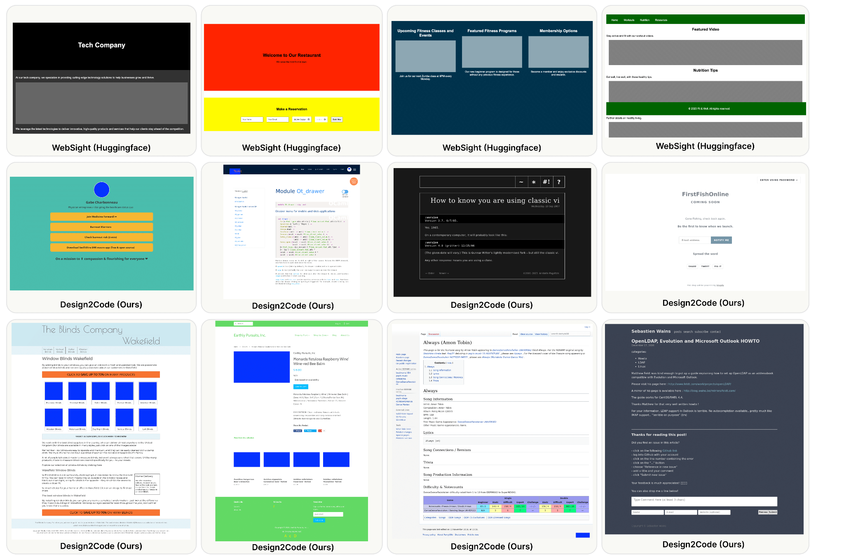
Demo: Design2Code
Fig. Test set examples

Slide 50
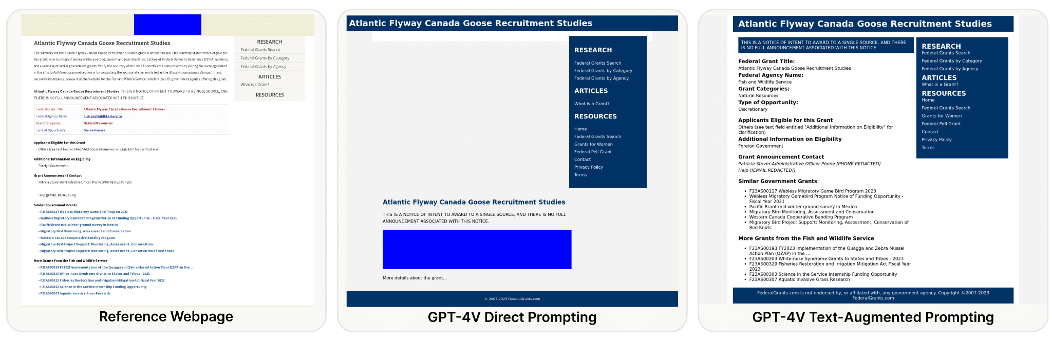
Demo: Design2Code
Fig. some case study examples to compare between different prompting methods and different models

Slide 51
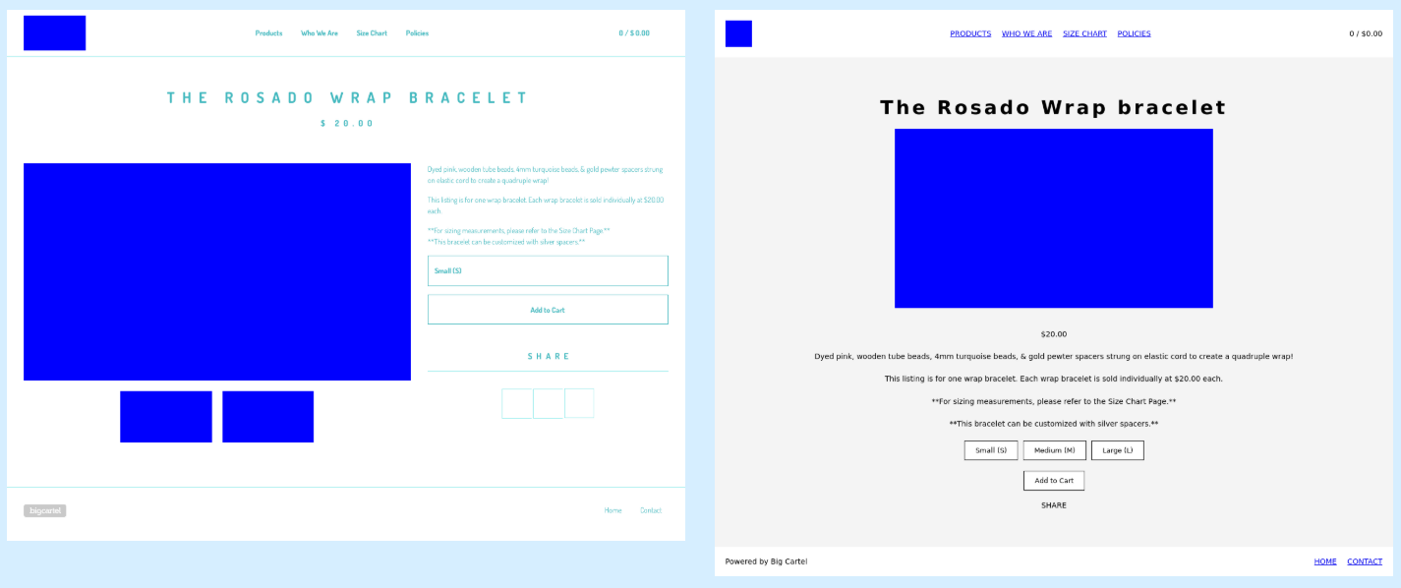
Demo: Design2Code
Fig. Examples of GPT-4V generated webpages in comparison with the original reference webpages. (Left: test dat)

Slide 52
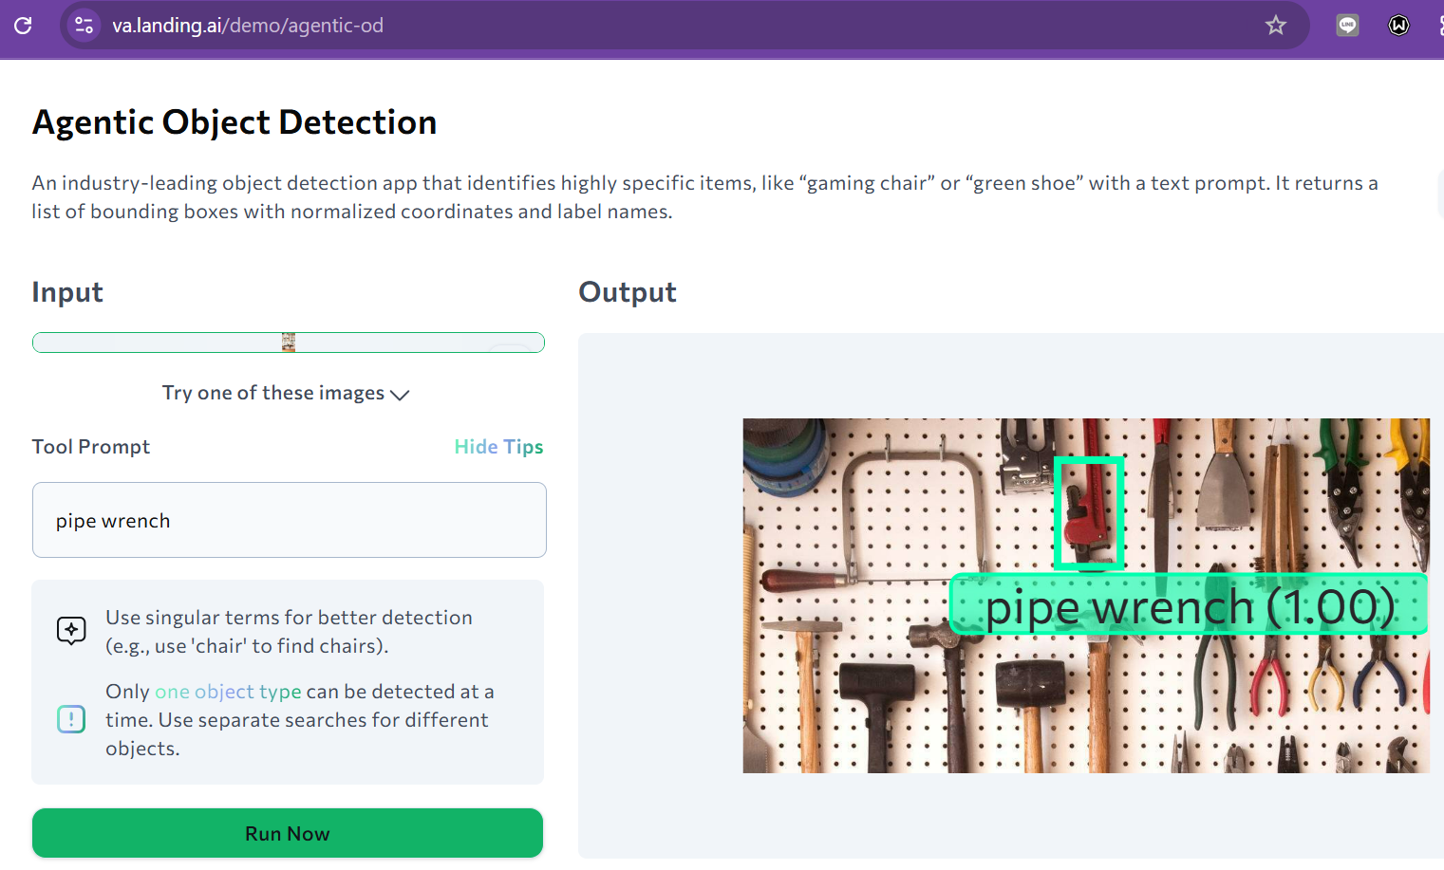
Demo: Agentic Object Detection
Link: https://va.landing.ai/demo/agentic-od

Slide 53
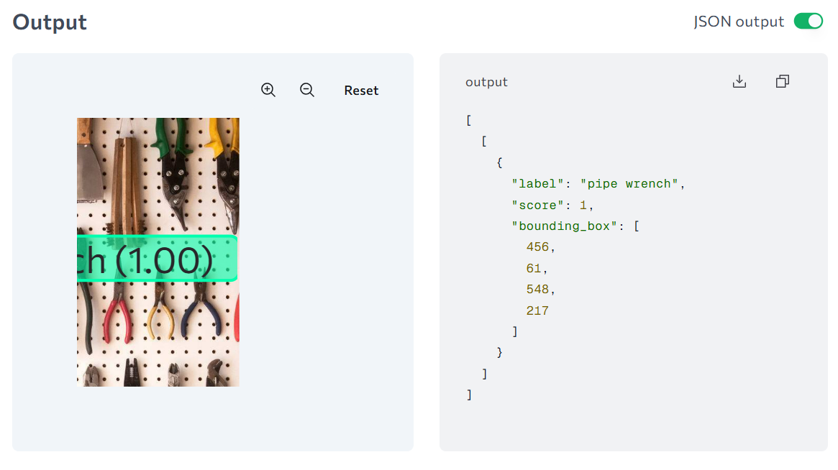
Demo: Agentic Object Detection
Fig. JSON output

Slide 54
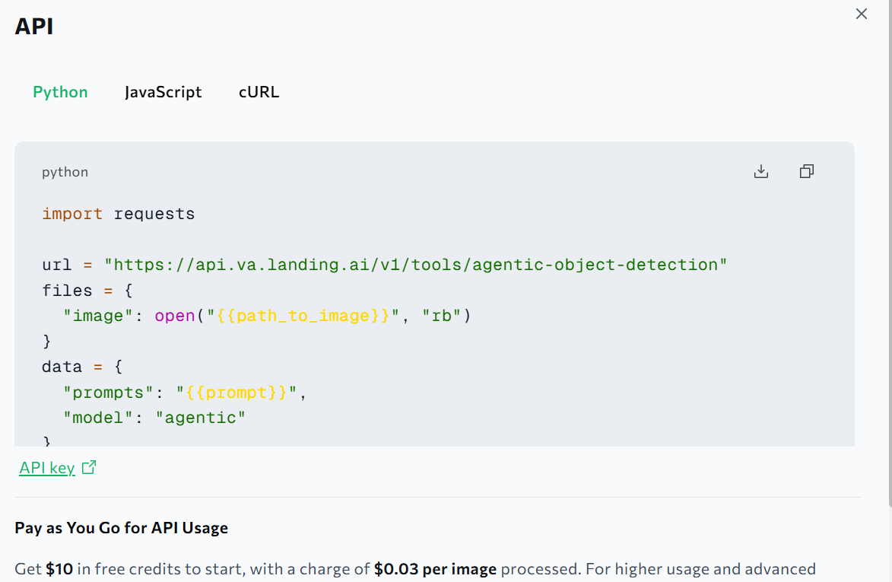
Demo: Agentic Object Detection
Fig. Python API

Slide 55
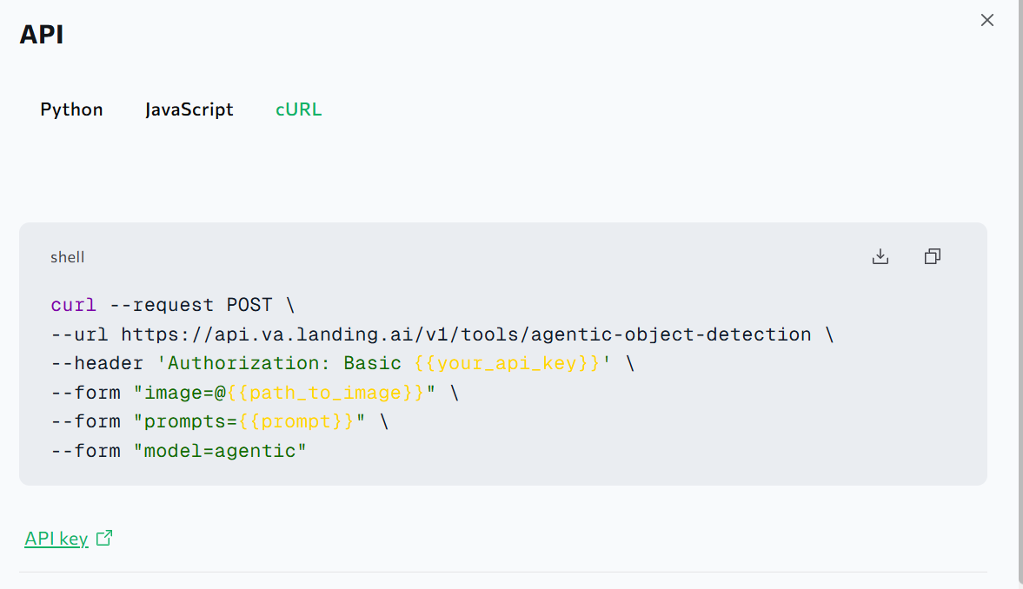
Demo: Agentic Object Detection
Fig. cURL

Slide 56
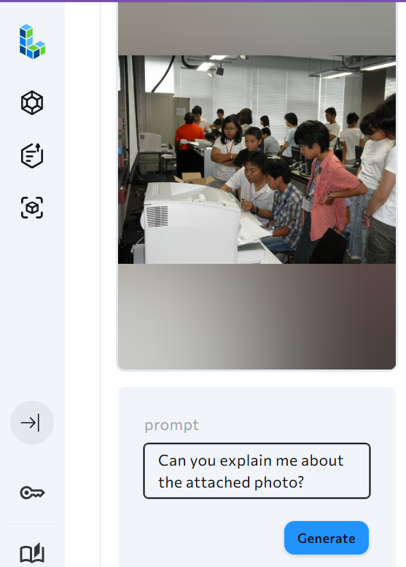
Demo: Visual Q&A
Prompt: Can you explain me about the attached photo?
Fig. Qwen2 VL Images VQA

Slide 57
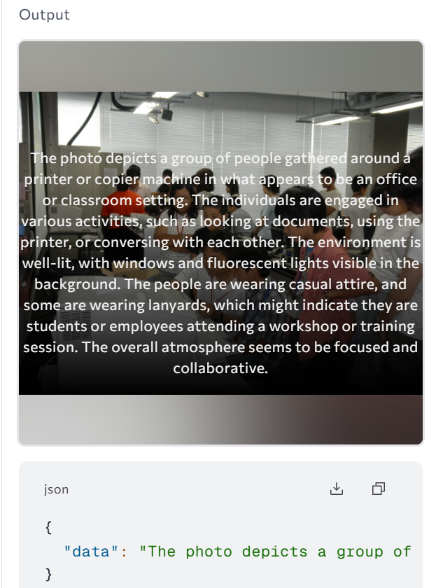
Demo: Visual Q&A
The photo depicts a group of people gathered around a printer or copier machine in what appears to be an office or classroom setting. The individuals are engaged in various activities, such as looking at documents, using the printer, or conversing with each other. The environment is well-lit, with windows and fluorescent lights visible in the background. The people are wearing casual attire, and some are wearing lanyards, which might indicate they are students or employees attending a workshop or training session. The overall atmosphere seems to be focused and collaborative.
Fig. Output

Slide 58
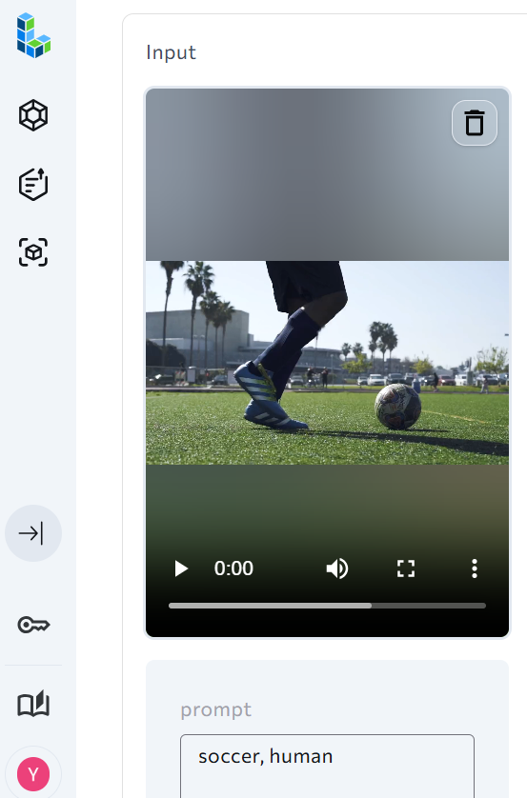
Demo: Video Tracking
Prompt: soccer, human
Fig. Florence-2 Sam2 Video Tracking

Slide 59
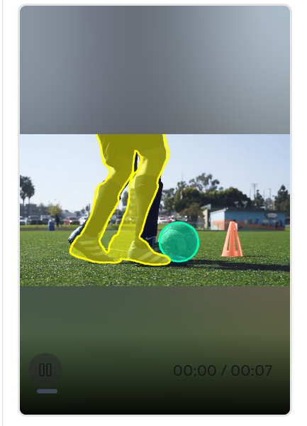
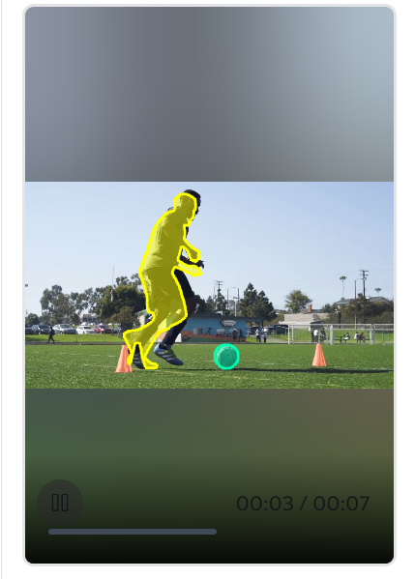
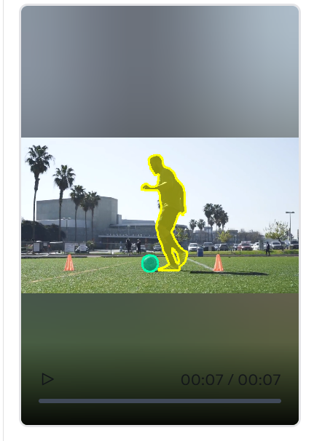
Demo: Video Tracking
Fig. Video tracking result for soccer and human

Slide 60

Don’t Build Multi-Agents
Link: https://cognition.ai/blog/dont-build-multi-agents#principles-of-context-engineering

Slide 61

Don’t Build Multi-Agents
Fig. Walden Yan (Cognition Labs, US) made the above claim

Slide 62

Don’t Build Multi-Agents
“Context engineering” is the next level of this
Take an example of a common type of agent. This agent
Breaks its work down into multiple parts
Starts subagents to work on those parts
Combines those results in the end

Slide 63

Don’t Build Multi-Agents

Slide 64



Don’t Build Multi-Agents
Flappy Game Link: https://flappybird.io/

Slide 65

Don’t Build Multi-Agents
Principle 1
Share context, and share full agent traces, not just individual messages
However, still unreilable
Fig. Context sharing among subagents

Slide 66

Don’t Build Multi-Agents
Fig. Walden Yan (Cognition Labs, US) made the above claim

Slide 67
Don’t Build Multi-Agents
Principle 2
Actions carry implicit decisions, and conflicting decisions carry bad results
I would argue that Principles 1 & 2 are so critical, and so rarely worth violating, that you should by default rule out any agent architectures that don’t abide by then.
You might think this is constraining, but there is actually a wide space of different architectures you could still explore for your agent.

Slide 68


Don’t Build Multi-Agents
Fig. Simple & reliable, the context is continuous
Fig. However, struggle with longer tasks

Slide 69

Don’t Build Multi-Agents
introduce a new LLM model whose key purpose is to compress a history of actions & conversation into key details, events, and decisions
This is hard to get right.
Fig. Reliable on longer tasks
Notes:
Depending on the domain, you might even consider fine-tuning a smaller model (this is in fact something we’ve done at Cognition).

Slide 70
Summary
Safety & Control
Sandboxing, credential management, and auditing will remain critical for secure agent deployment.
LLM Advancements
Continued investment in training will enhance capabilities while reducing costs.
Benchmarking Challenges
Evaluation methods will improve, but measuring true agent intelligence remains difficult.

Slide 71
Summary
Invisible Integration
Agents will increasingly operate through native interfaces, making software interactions less visible.
Accelerating Progress
Development cycles will shorten, and agents will soon autonomously build other agents.

Slide 72
References
Agent AI: Graham Neubig, Professor, SCS, Carnegie Mellon University. Co-Founder, All Hands AI: https://www.youtube.com/watch?v=DNKb1IoJoaU
Design2Code: How Far Are We From Automating Front-End Engineering? https://github.com/NoviScl/Design2Code?tab=readme-ov-file
CMU Advanced NLP Fall 2024 (15): Tool Use and LLM Agent Basics: https://www.youtube.com/watch?v=a3SjRsqV9ZA&t=1s
CMU Advanced NLP Fall 2024 (16): Agents for Software Development and Web Browsing: https://www.youtube.com/watch?v=lcNVAyNlp20&t=1s
Stanford Webinar - Agentic AI: A Progression of Language Model Usage: https://www.youtube.com/watch?v=kJLiOGle3Lw&t=2s

Slide 73
References
LU Lab GitHub: https://github.com/ye-kyaw-thu
Shumaker et al. Animal tool behavior: the use and manufacture of tools by animals. JHU Press, 2011
ToolkenGPT: Augmenting Frozen Language Models with Massive Tools via Tool Embeddings, Shibo Hao, Tianyang Liu, Zhen Wang, Zhiting Hu, https://arxiv.org/abs/2305.11554
WebArena: A Realistic Web Environment for Building Autonomous Agents, Shuyan Zhou, Frank F. Xu, Hao Zhu, Xuhui Zhou, Robert Lo, Abishek Sridhar, Xianyi Cheng, Tianyue Ou, Yonatan Bisk, Daniel Fried, Uri Alon, Graham Neubig, https://arxiv.org/abs/2307.13854
Building AI Agents That Actually Remember: A Developer’s Guide to Memory Management in 2025, Nayeem Islam: https://medium.com/@nomannayeem/building-ai-agents-that-actually-remember-a-developers-guide-to-memory-management-in-2025-062fd0be80a1

Slide 74
References
OpenHands: An Open Platform for AI Software Developers as Generalist Agents, Xingyao Wang, Boxuan Li, Yufan Song, Frank F. Xu, Xiangru Tang, Mingchen Zhuge, Jiayi Pan, Yueqi Song, Bowen Li, Jaskirat Singh, Hoang H. Tran, Fuqiang Li, Ren Ma, Mingzhang Zheng, Bill Qian, Yanjun Shao, Niklas Muennighoff, Yizhe Zhang, Binyuan Hui, Junyang Lin, Robert Brennan, Hao Peng, Heng Ji, Graham Neubig, https://arxiv.org/abs/2407.16741
Mind2Web: Towards a Generalist Agent for the Web, Xiang Deng, Yu Gu, Boyuan Zheng, Shijie Chen, Samuel Stevens, Boshi Wang, Huan Sun, Yu Su, https://arxiv.org/abs/2306.06070
Mind2Web Project Link: https://osu-nlp-group.github.io/Mind2Web/
Flappy Bird Game: https://flappybird.io/
Design2Code Project Page: https://salt-nlp.github.io/Design2Code/

Slide 75
References
Andrew Ng Explores The Rise Of AI Agents And Agentic Reasoning | BUILD 2024 Keynote: https://www.youtube.com/watch?v=KrRD7r7y7NY&list=PLW0CAVDRXv0Y7LxtdHAqx_QedUt8HIsKc
Agentic Object Detection: https://va.landing.ai/demo/agentic-od
Qwen2 VL Images VQA: https://va.landing.ai/demo/api/Qwen2%20VL%20Images%20VQA
Andrej Karpathy: Software Is Changing (Again): https://www.youtube.com/watch?v=LCEmiRjPEtQ
Awesome LLM Apps: https://github.com/Shubhamsaboo/awesome-llm-apps

Slide 76
Thank you!
Homepage: https://sites.google.com/site/yekyawthunlp/
GitHub: https://github.com/ye-kyaw-thu
Email: ykt.nlp.ai@gmail.com

